Slide 1
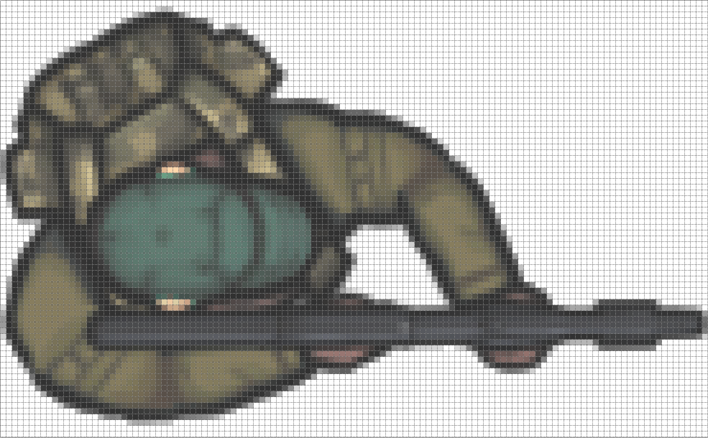
128
Center of Rotation
76
Gun Offset
Center
Offset
End of
Gun Barrel

Slide 2
Scanning
Player close or vulnerable
Waiting
event
Scanning
event
Alert event
Alert
Waiting
Player close or vulnerable
Aim and Gun fire event
Frame event for last frame
Reloading

